Slide 1



Presentation
Cross-border e-commerce borrow-sell platform
Northeastern University
Software Engineering(International (English)) 1702
李远识

Slide 2

Contents Page
3. Innovation & Highlight
5. Future Improvement
& Conclusion
1. Overview
2. Development Environment & Tools
4. Project Presentation

Slide 3

Overview
PART 1

Slide 4
Part I
Overview
MVO Info Manage
Wallet
Frontend and backend work
Wallet admin frontend & backend work. Part of MVO/BVO wallet backend work.
MVO product Manage
Parameter Management
Work
Part of backend work
All the work
MVO order Manage
Code Master Manage
Frontend and backend work
All the work
Test Work

Slide 5

Development
Environment
&
Tools
PART 2

Slide 6
Part II
Development Environment & Tools
Environment
Tools
JDK 1.8
MySQL Ver 8.0.20
SpringBoot 2.3.1
Mybatis
Mybatis – plus Spring Starter 3.1.0
Etc.
IDEA 2020.1.1
Navicat Premium 12
MySQL workbench
VS Code

Slide 7

Innovation
&
Highlight
PART 3

Slide 8
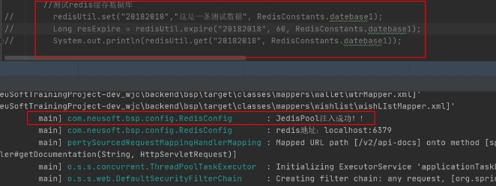
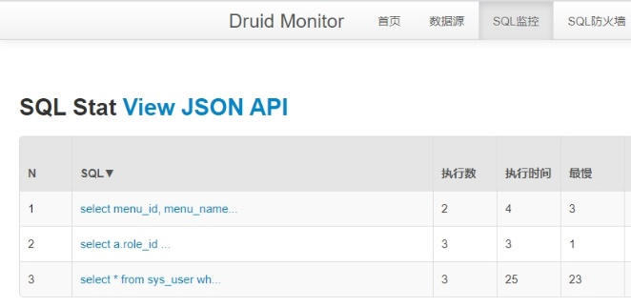
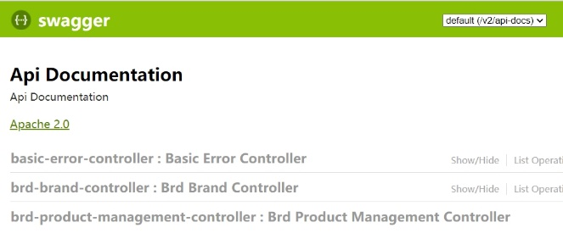
Part III
Innovation & Highlight
Druid Pool
Provide database connection
Monitor the SQL
Firewall
Swagger UI
Finish config work
Helps a lot when testing backend work
Jedis
Finish config work
Test successfully when using in BrdProductController

Slide 9
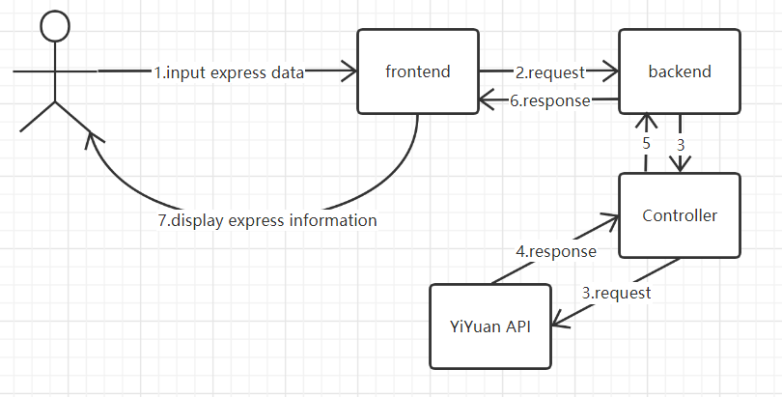
Part III
Innovation & Highlight
YiYuan API

Slide 10

Project
Presentation
PART 4

Slide 11
Part IV
Project Presentation
Local:
http://localhost:9527/
Network:
http://192.168.0.105:9527/

Slide 12

Future
Improvement
&
Conclusion
PART 5

Slide 13


Part V
Future Improvement & Conclusion
A team is so important!!!!!!!
More people, more power.
Team work
Redis
TEST
This project only completed the configuration and testing of Redis, and I did not apply it to the project. I hope that Redis can be used in the project to improve the efficiency of CURD operation of database.

Slide 14





Thanks for listening

